Slide 1
Working with Amazon’s Alexa Skills Kit
Notes:
Talking Points:

Slide 2
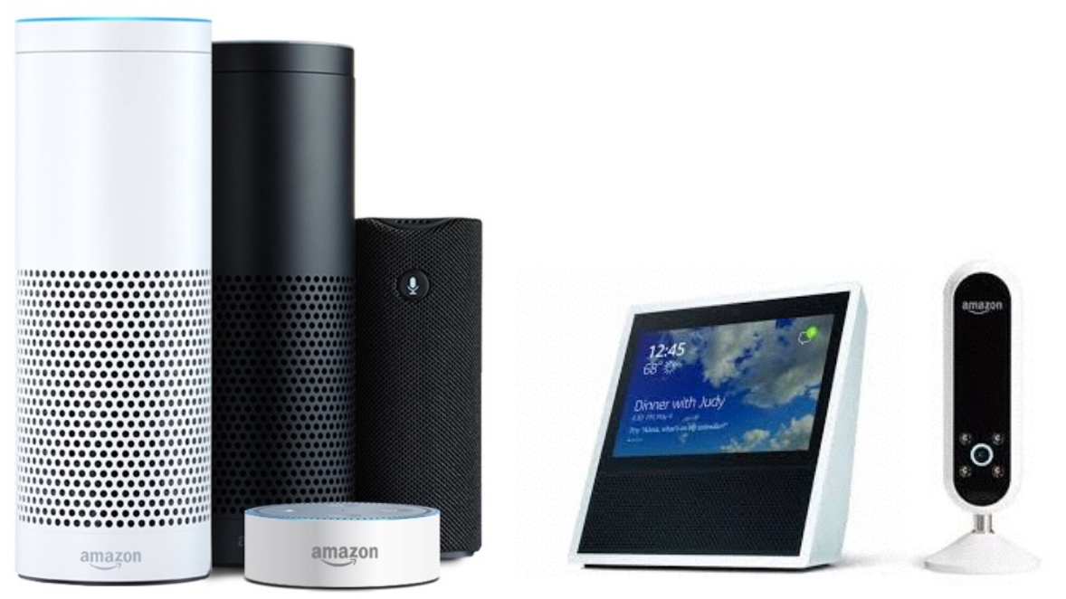
Available Amazon Devices

Slide 3
How the world views Alexa and our subscribers
Saturday Night Live did a faux commercial for Alexa Silver, an Alexa designed for “the greatest generation”:
http://www.nbc.com/saturday-night-live/video/amazon-echo/3518896?snl=1
Amazon Alexa VP Toni Reid agreed that the SNL spoof is “actually spot on”
https://www.geekwire.com/2017/amazon-alexa-chief-saturday-night-live-spoof-echo-speaker-actually-kind-spot/

Slide 4
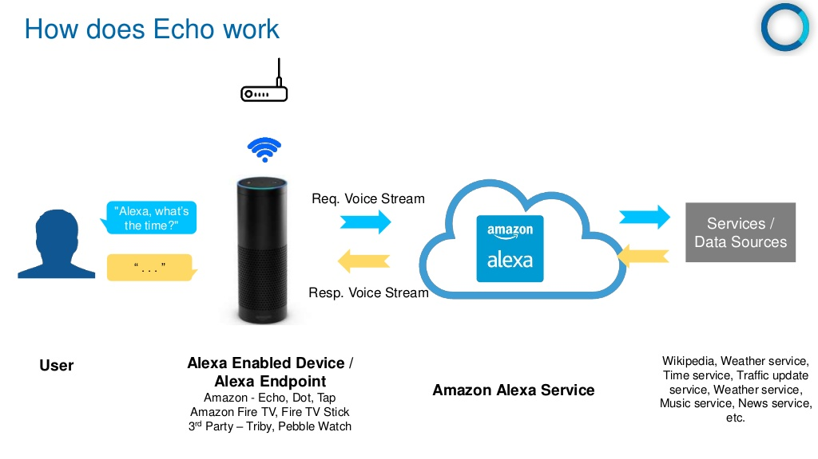

Slide 5
Definition of Terms
Wake Word: The word used to start an interaction with an Amazon device. Current wake words are: Alexa, Echo, Amazon, and Computer.
Invocation Name: The two or more word name that a user will use to start a dialog.
Skill: The application that responds to an invocation
Intent: The action or request that a user can interact with.
Utterance: The words that a user will use to invoke an intent
Slot: Custom values used in intents.

Slide 6
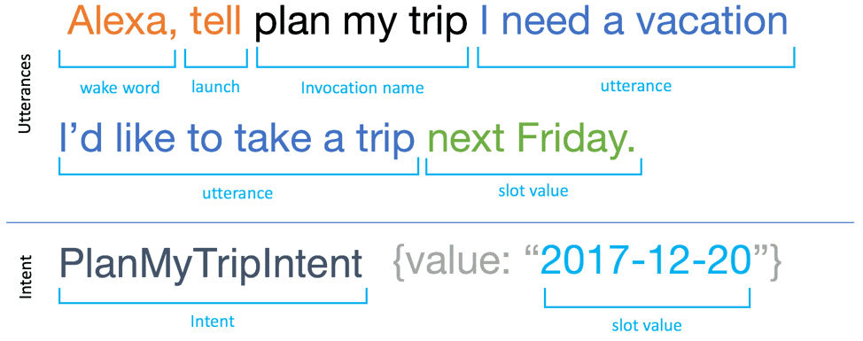
Putting the terms together as a skill

Slide 7
Voice Design
Designing your skill to mimic human conversation.
Think through how your users will interact with your skill.
Skipping this step will result in a skill that will not work well with your users.
Do not use a flow chart to represent how a conversation may branch!
Flow charts are not conversational.
Instead of flow charts, you should use situational design.

Slide 8
Situational Design
Situational Design is a voice-first method to design a voice user interface.
Start with a simple dialog.
Each interaction between your user and the skill represents a turn.
Each turn has a situation that represents the context.
If it's the user’s first time interacting with the skill, there is a set of data that is unknown.
In this situation, the skill will ask basic questions, such as when were you born?
However, if this isn’t the first time, the skill should respond differently.

Slide 9
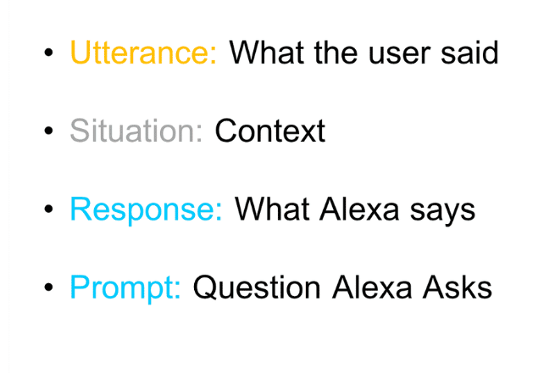
Situational Design has four parts

Slide 10
Birth Date Example 1
Utterance: Open Birth Day
Situation: Unknown Birthday
Response: Hello. Welcome to cake walk.
Prompt: When is your birthday?

Slide 11
Birth Date Example 2
Utterance: Open Birth Day
Situation: Known Birthday (today)
Response: Happy Birthday!
Prompt: N/A

Slide 12
Birth Date Example 3
Utterance: Open Birth Day
Situation: Known Birthday (not today)
Response: There are n days until your birthday
Prompt: N/A

Slide 13
Some things to consider
When asking for a birthday, you want to be able to handle a full response (month, day, year) as well as a partial response (Under filling).
What happens if a user gives a partial answer? https://www.youtube.com/watch?v=cn308bvNBq4&feature=youtu.be
Additionally, the user may give you too much information (Over filling).
What happens if a user gives too much information?
https://www.youtube.com/watch?v=Gr59BrDWnIE&feature=youtu.be

Slide 14
Let’s look at the code…
Developer Console
Birth Day Skill:
CaptureBirthdayIntent
Slots:
day
month
Year
Node.js (index.js):
Unknown Birthday:
LaunchRequestHandler
CaptureBirthdayIntentHandler
Known Birthday:
HasBirthdayLaunchRequestHandler

Slide 15
Tools to use
Birth Day (Cake Walk) Exercise:
https://developer.amazon.com/en-US/alexa/alexa-skills-kit/courses/cake-walk
Alexa Developer Console:
https://developer.amazon.com/edw/home.html#/
Amazon Web Services (AWS):
https://console.aws.amazon.com/console/home
Lambda service – Hosts services
CloudWatch – Logs
Blueprints:
https://blueprints.amazon.com/
Skill Testing Tool:
https://echosim.io/welcome

Slide 16
Questions?

